Slide 1

IAM Uncertainty and Model Validation or, what are these models good for anyway?
Integrated Human-Earth System Modeling and Policy Assessment
Steven J. Smith
Joint Global Change Research Institute
College Park, MD
Center for Global Sustainability
University of Maryland
ssmith@pnnl.gov

Slide 2




Outline
Background
What is an IAM
Motivation
Uncertainty
Sources of uncertainty
Retrospective – SRES scenarios
A couple more examples
Model validation/evaluation
Definitions and theory
Energy-economic and IAM models

Slide 3
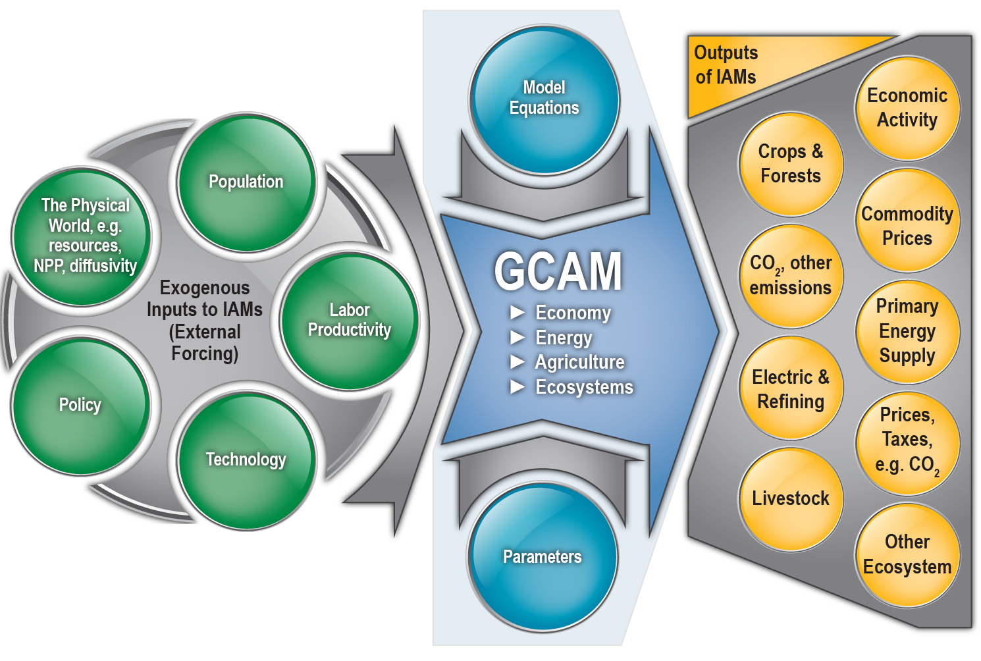
What is an integrated assessment model?
IAMs combine information from numerous disciplines into one framework
Each model makes different tradeoffs between completeness and complexity, depending on its purpose.
* While this diagram refers to GCAM, the high-level structure is similar to other IAMs.
IA Models Are Not “Truth Machines”
IA models are not predictive — we can’t “forecast” many of the most important factors such as technology or human socio-economic developments.
IA Models Are Tools, useful to examine:
different assumptions for technology, economic growth, ... (e.g. emission scenarios)
the relative costs of GHG emissions reductions under different assumptions

Slide 4
Motivation: Cost of emissions mitigation
Wide range of results:
Why are these different?
Which results are more likely to be correct? (Or more useful?)
Source: IPCC AR6, WG III. Figure 3.33

Slide 5
Part I Uncertainty

Slide 6
Some Sources Of Uncertainty in IAMs
Input Assumptions
Climate response
Socioeconomic drivers: Economic Activity (GDP), Population
Future evolution of technology costs
Endogenous technological change
Introduction of new technologies
Fossil and non-fossil resources
Historical/base-year energy/emissions
Evolution of service demands (Transportation, Building, Industry)
Response of demands to price changes (long-term, medium-term)
Technology choice mechanism/assumptions
Trade
Model Dynamics/Structure
Rough progression

Slide 7
Lets compare an set of projections published in 2000 to history since then
We will look at at set of scenarios developed for the IPCC Special Report on Emissions Scenarios (SRES), which were published in 2000.
The SRES scenarios were developed by different Integrated Assessment Models (IAMs) and represent a set of reference case (no climate policy) pathways from 2000 to 2100.
How does these projections produced 20+ years ago compare to historical developments since then?

Slide 8
Case Study: SRES Scenarios
We will look at at set of scenarios developed for the IPCC Special Report on Emissions Scenarios (SRES), which were published in 2000. Lets look at how they compare to history since then:
A comparison published in 2010 found:
Estimated emissions history up to 2008 was within the range, but on the high side.
Recession in 2009 brought emissions closer to center of distribution.
These were long-term projections with 10-15 year model time-steps. Need to compare over similarly long-time frames! (1-3 decades)
Black Dots: CDIAC CO2 – circa 2009
Manning M, T Carter, JA Edmonds, A Grubler, KA Hibbard, M Kainuma, T Kram, M Meinhausen, RH Moss, N Nakicenovic, K Riahi, SK Rose, SJ Smith, R Swart, and D Van Vuuren (2010) Misrepresentation of the IPCC CO2 emission scenarios Nature Geoscience 3 pp. 376-377.
Notes:
Mention the need for observations – in this case we have emission estimates.

Slide 9
Case Study: SRES Scenarios
Continue the comparison – but with more recent data.
Using the most historical estimates: actual emissions remained in the high end of the range through ~2015, but are now near the upper mid-range.
Some, amount of the recent flattening is due to climate-related policies. (SRES are “no policy” scenarios, so not 100% comparable.)

Slide 10
Case Study: SRES Scenarios
Continue the comparison – but with more recent data.
Using the most historical estimates: actual emissions remained in the high end of the range through ~2015, but are now near the upper mid-range.
Note differences/changes in historical estimates (some is uncertainty, some is updated data/assumptions)

Slide 11
Why were many of the projections lower than historical CO₂ emissions out to 2015?
Compare w/ history and more recent SSP scenarios
One reason is historical developments in China

Slide 12
Why were many of the projections lower than historical CO2 emissions?
SSP: 5-year intervals
SRES: 15 year intervals
By 2035, SRES growth rate range similar to the more recent SSP scenarios.
But SRES did not anticipate the post 1990 high growth period.
Looking at Rates of Growth. These compound over time!

Slide 13
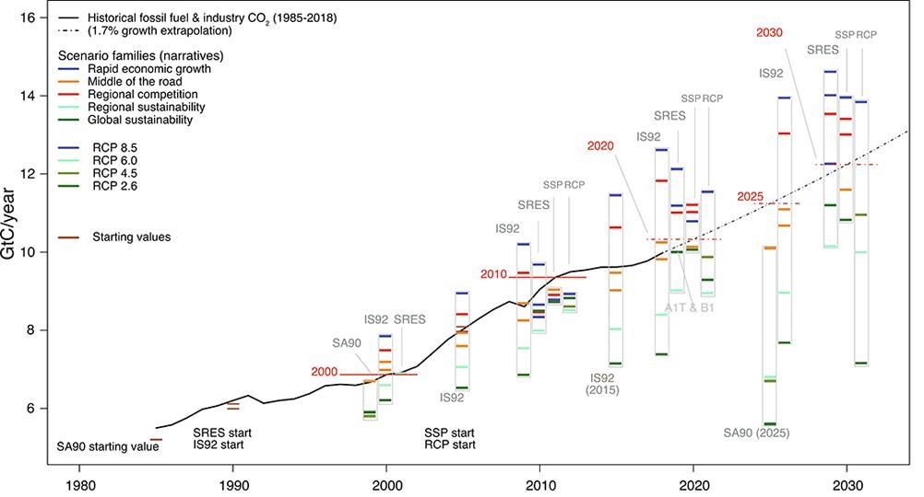
Similar results found in a more comprehensive comparison
Pedersen, J.S.T., Santos, F.D., van Vuuren, D., Gupta, J., Coelho, R.E., Aparício, B.A. and Swart, R., 2021. An assessment of the performance of scenarios against historical global emissions for IPCC reports. Global Environmental Change, 66, p.102199.

Slide 14
Two More Uncertainty Examples

Slide 15
What do historical trends tell us about near-term trajectories?
What does the preceding 5 years tell us about the next 10 years?
Thick line CDIAC historical CO2 emissions.
10-year linear extrapolations based on the proceeding 5-year trend at each point.
Difference (%) between the 10-year linear projection and historical estimate for that year.
The 5-95% range is about ±45%.
Van Vuuren, Detlef, Edmonds, J, Smith, S J, Nakicenovic, N., Thomson, A M, Calvin, K V, Karas, J, Riahi, K, van Ruijven, B, Swart, R (2010) What do near-term observations tell us about long-term developments in greenhouse gas emissions? Climatic Change 103 (3-4), 635-642. DOI: 10.1007/s10584-010-9940-4.

Slide 16
Uncertainties: Current Emissions
AR6 WG III, Chapter 2, §2.2.1
AR6 WG III, Chapter 2, §2.2.1
Have been focusing on uncertainties in future projections, but even current conditions are not known with certainty. One aspect of this is uncertainty in anthropogenic emissions.
What influences these uncertainty levels?
Why do some emissions species have uncertainties much higher than others?
AR6 WG III, Chapter 2, §2.2.1
Notes:
Physics an chemistry influence these.

Slide 17
Conclusions
What are your thoughts about the validity of IAM projections?
We will have a discussion shortly.
Notes:
Uncertainties in historical data (vs scenarios that are harmonized to start at one point)
The world does not always change in a smooth manner.
-- This is particularly true for policies! (e.g. China SO2)
The future is difficult to predict, but we can learn something from dynamical modeling

Slide 18
Part II Model Validation/Evaluation

Slide 19
Definitions
“Given inevitable flaws and uncertainties, how should computational results be viewed by those who wish to act on them? The appropriate level of confidence in the results must stem from an understanding of a model’s limitations and the uncertainties inherent in its predictions. Ideally this understanding can be obtained from three interrelated processes that answer key questions:
Verification. How accurately does the computation solve the underlying equations of the model for the quantities of interest?
Validation. How accurately does the model represent reality for the quantities of interest.
Uncertainty quantification (UQ). How do the various sources of error and uncertainty feed into uncertainty in the model-based prediction of the quantities of interest?”
NAS (2012) ISBN 978-0-309-25634-6
However, the first sentence in the summary of this report is:
Computational models that simulate real-world physical processes are playing an ever-increasing role in engineering and physical sciences.
How might these principles apply to models of the socioeconomic system?

Slide 20
Lessons and Observations?
When is it possible to validate any model?
While models of physical systems, in principle, may satisfy some of these requirements, Oreskes et al. (1994) argue that models of natural systems can never be validated.
Verification and validation of numerical models of natural systems is impossible. This is because natural systems are never closed and because model results are always non-unique. Models can be confirmed by the demonstration of agreement between observation and prediction, …. The primary value of models is heuristic.
Hodges & Dewar (1992) proposed the following (widely cited) criteria:
Modeled variables are observable,
Relationships exhibit constancy of structure in time,
Exhibit constancy across variations in conditions not specified in the model, and
Permit the collection of ample and accurate data.
Hodges, J. S. (1991). "6 (or So) Things You Can Do with a Bad Model." Operations Research 39(3): 355-365.
Oreskes, N., K. Shraderfrechette, et al. (1994). "Verification, Validation, and Confirmation of Numerical-Models in the Earth-Sciences." Science 263(5147): 641-646.

Slide 21
Validation is an issue that physical models have long dealt with.
One run from each CMIP3 model per SRES scenario.
Climate models give a wide range of results even over the historical era.
Climate results are usually presented as normalized over a common historical period…
Notes:
Aid in the communication of results?
Projections not forecasts.
What, really, do our models say about future bounds or limits?
Diagnostics – future scenario behavior as compared to history.
What would further aid “thinking and hypothesizing”?
Important since IAMs, by necessity, go far outside of historical experience.

Slide 22
How About IAMs?
Modeled variables are observable,
Relationships exhibit constancy of structure in time,
Exhibit constancy across variations in conditions not specified in the model, and
Permit the collection of ample and accurate data.
Hodges & Dewar (1992)
For energy system models, Scher & Koomey (2011) state:
Physical systems generally exhibit such structural constancy, but economic and social systems do not. Dynamic market forces, influenced by non-linear technological and behavioral changes, are highly uncertain and are subject to rapid changes. Consequently, economic modelers cannot assume a level of structural rigidity in the economy sufficient to satisfy criteria 2 and 3 above. As a result, models that attempt to describe economic systems will not yield accurate results, especially in the long term.
So what are such models good for?
Scher, I. and J. G. Koomey (2011). "Is accurate forecasting of economic systems possible?" Climatic Change 104(3-4): 473-479.

Slide 23
Use of Energy-Economic Models
“Ultimately, economic and technological modelers need to face the fundamental reality of inconstancy in structural relationships. Economic systems are not the same as physical systems, and we shouldn’t model them as if they are. This does not mean that we cannot say anything useful about the future, just that we need to change how we think about these problems and use different terminology and tools to generate insights.”
Scher & Koomey (2007)
Craig et al. (2002), expanding on Hodges & Dewar (1992), identify several uses, some of which have long been identified by the IAM community.
1. As a bookkeeping devices,
2. as an aid in selling an idea or achieving political ends,
3. as a training aids,
4. as part of an automatic management system whose efficacy is not evaluated by using the model as if it were a true representation,
5. as aids in communication and education,
6. to understand the bounds or limits on the range of potential outcomes, and
as aids to thinking and hypothesizing.
Craig, P. P., A. Gadgil, et al. (2002). "What can history teach us? A retrospective examination of long-term energy forecasts for the United States." Annual Review of Energy and the Environment 27: 83-118
Notes:
Aid in the communication of results?
Projections not forecasts.
What, really, do our models say about future bounds or limits?
Diagnostics – future scenario behavior as compared to history.
What would further aid “thinking and hypothesizing”?
Important since IAMs, by necessity, go far outside of historical experience.

Slide 24
Validation/Evaluation of IAMs?
When thinking about model validation/evaluation, need to recall the structure of IAM models
Need to think about what is “inside” and “outside” the model
Note that the distinction is often not clean-cut.
The community is continuing to grappling with these issues:
Some preliminary hindcast experiments have been done
There is also a focus on diagnostics (historical vs model projections)

Slide 25
END

